Slide 1
The most popular genres
by extracting data. we can conclude that the most popular genre is Rock as achieving the highest selling quantity compared to the rest of genres, also we can say the Latin genre is some what popular as it achieving the second highest genres demanded in market

Slide 2
The highest profitable customers
Here we picked up the highest 15 profitable customer who have purchased our products, we can give them some advantages like discounts or some premium services with lower cost to maintain the loyalty of these customers to the store

Slide 3
the most profitable artists
Here we picked up the most profitable artists to the store. We could make these artists in our priority so as to get their songs once it released as they are the main pillars we depend on for our income. We can get one of them to promote our store as they have a huge popularity.

Slide 4
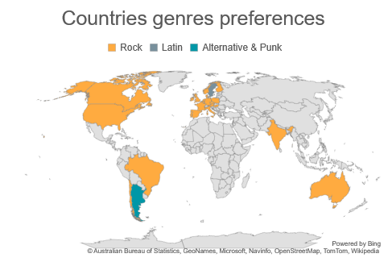
the most trending genre in each country
We have seen that how Rock genre occupied the highest portion of the market. but the quaintly demanded may be concentrated in a specific area. So we couldn’t conclude that the Rock genre is the most popular around the world.so, we queried the dataset to saw the most popular genre around the world. And we found the Rock music is the dominant genre in the most of the countries except Sweden and Argentina they prefer Latin and Alternative & Punk respectively

